Slide 1

DESIGN AND IMPLEMENTATION
OF ENVIRONMENTAL WASTE MANAGEMENT SYSTEM
FOR EFFECTIVE WASTE DISPOSAL
Thanks
Features
Problems
Methodologies
Objectives
Implementation
BY:
Chukwuleta Tobechi
Chibuokem Jerry

Slide 2
PROJECT AIM
This work aims to design and implement an environmental waste management system for effective waste disposal.
PROJECT OBJECTIVE
Thanks
Features
Problems
Objectives
Methodologies
Implementation
To implement a ‘pay as you generate’ waste management system to help reduce waste produced
To encourage the reusability of valuable waste items and materials
To encourage recyclability by ensuring proper usage of the different waste bags in collection of waste

Slide 3
Problem
Problem
Problem
1
2
3
General Dumpsite that has led to pollution and inefficient waste management
Improper usage of waste bin that inhibit recyclability of waste
Fewer resources available for scavengers to help reusability of waste materials
Thanks
Features
Problems
Methodologies
Objectives
Implementation

Slide 4



Features
Thanks
Problems
Implementation
Methodologies
Objectives
R
R
R
REDUCE
REUSE
RECYCLE
The system ensures users pay for the exact amount of waste generated. So, less waste, lesser bills.
A feature named market place where users can upload valuable scrap items for sale at cheap prices.
Wastes are well organized in different waste bins to guarantee ease in recyclability

Slide 5
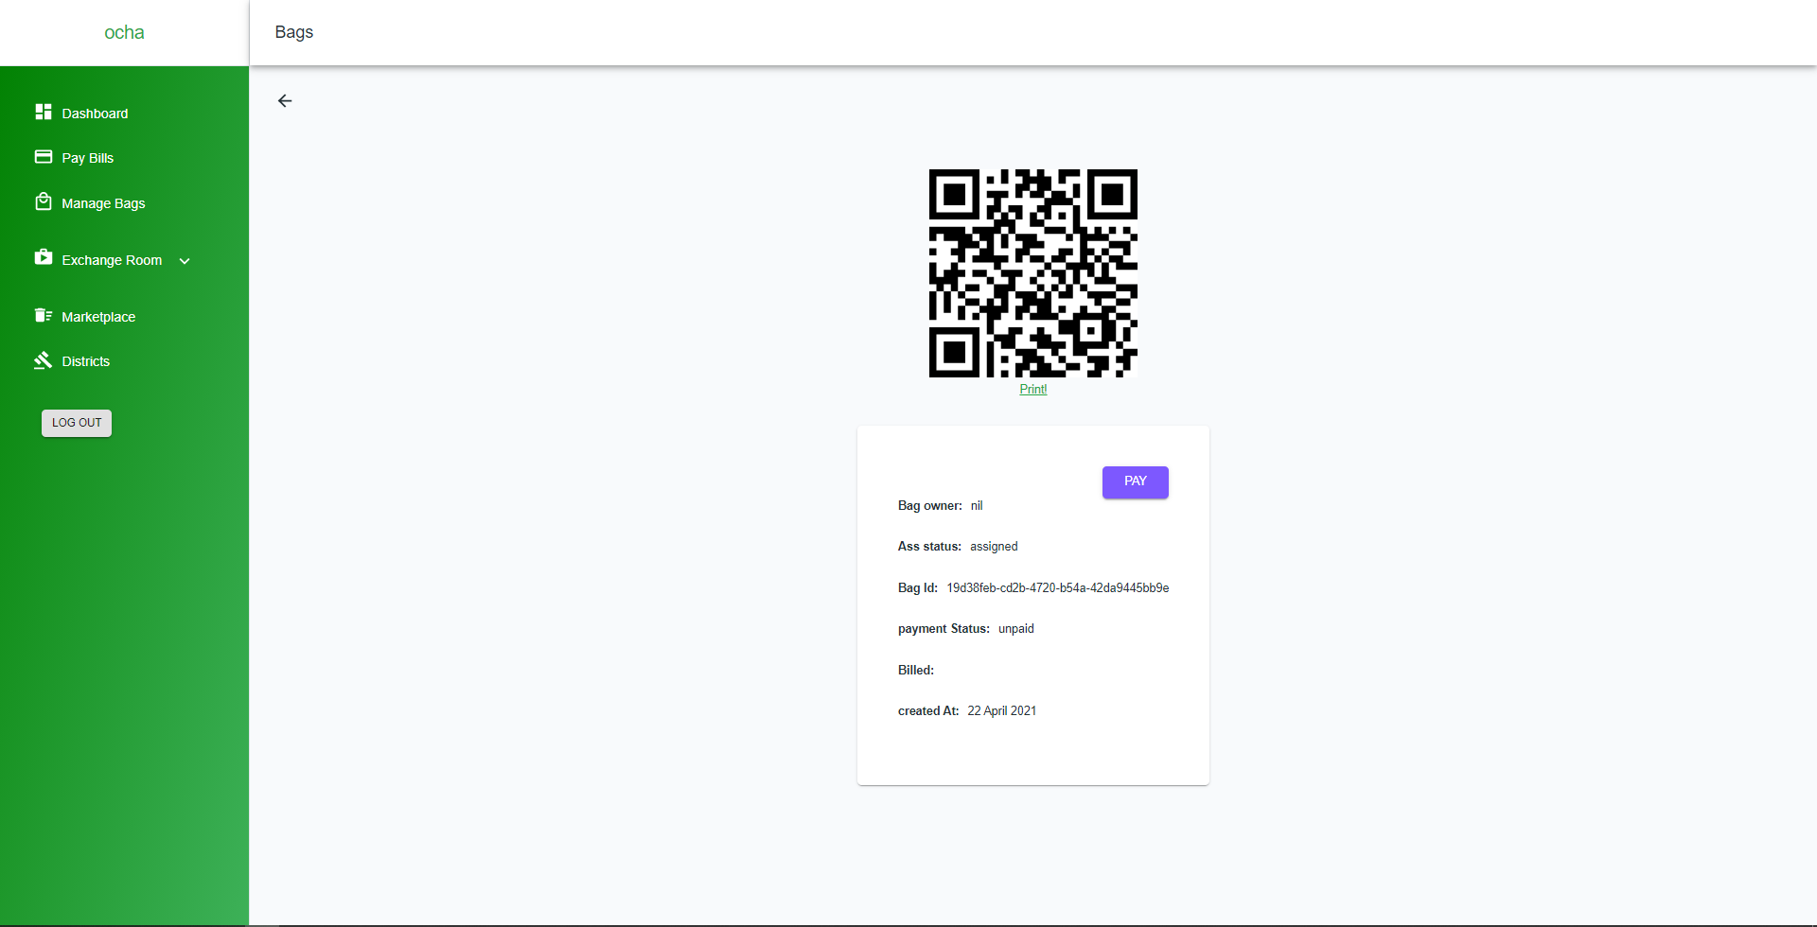
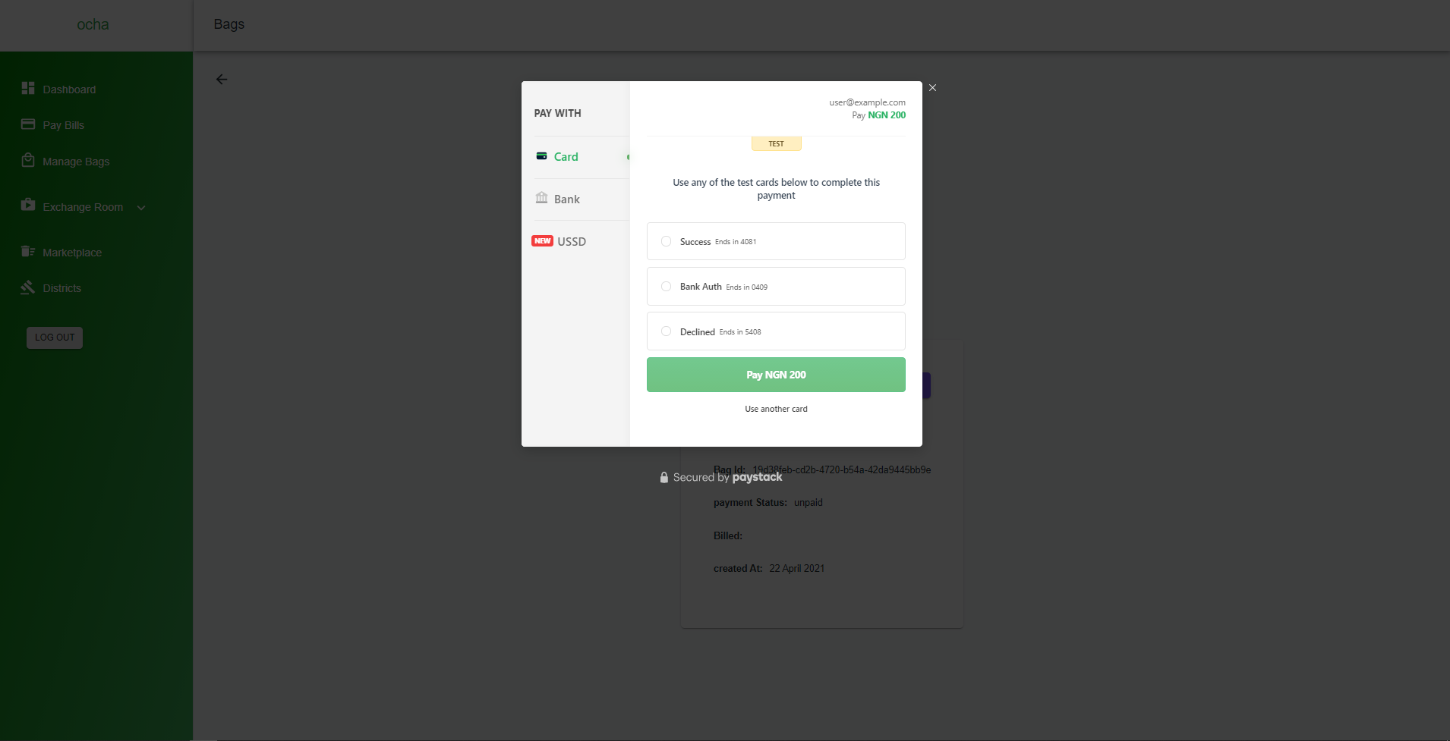
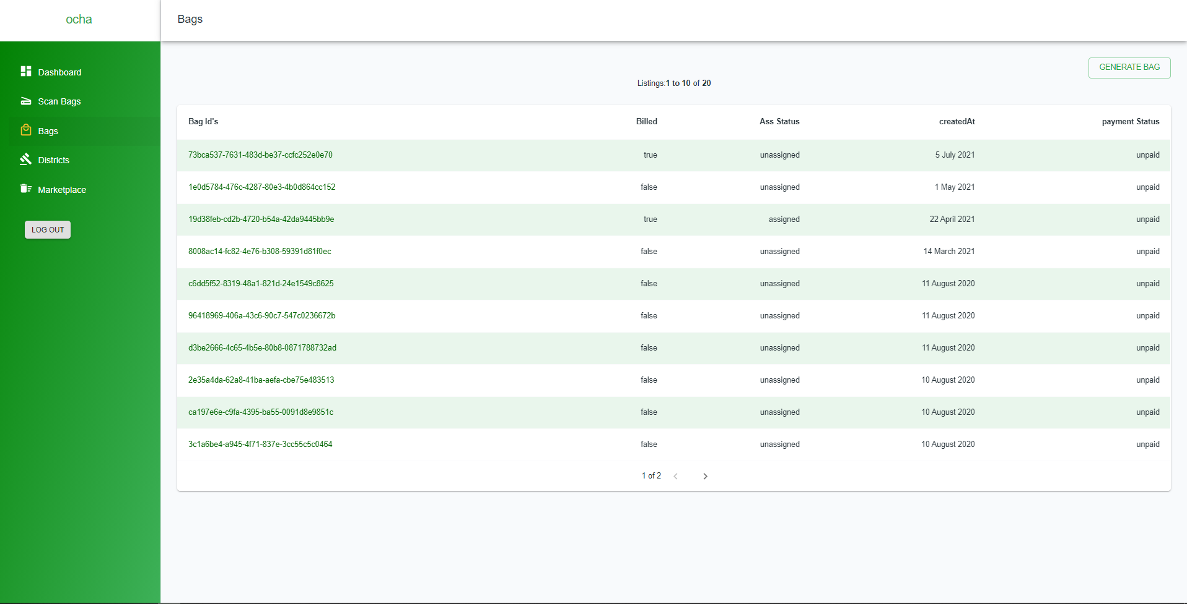
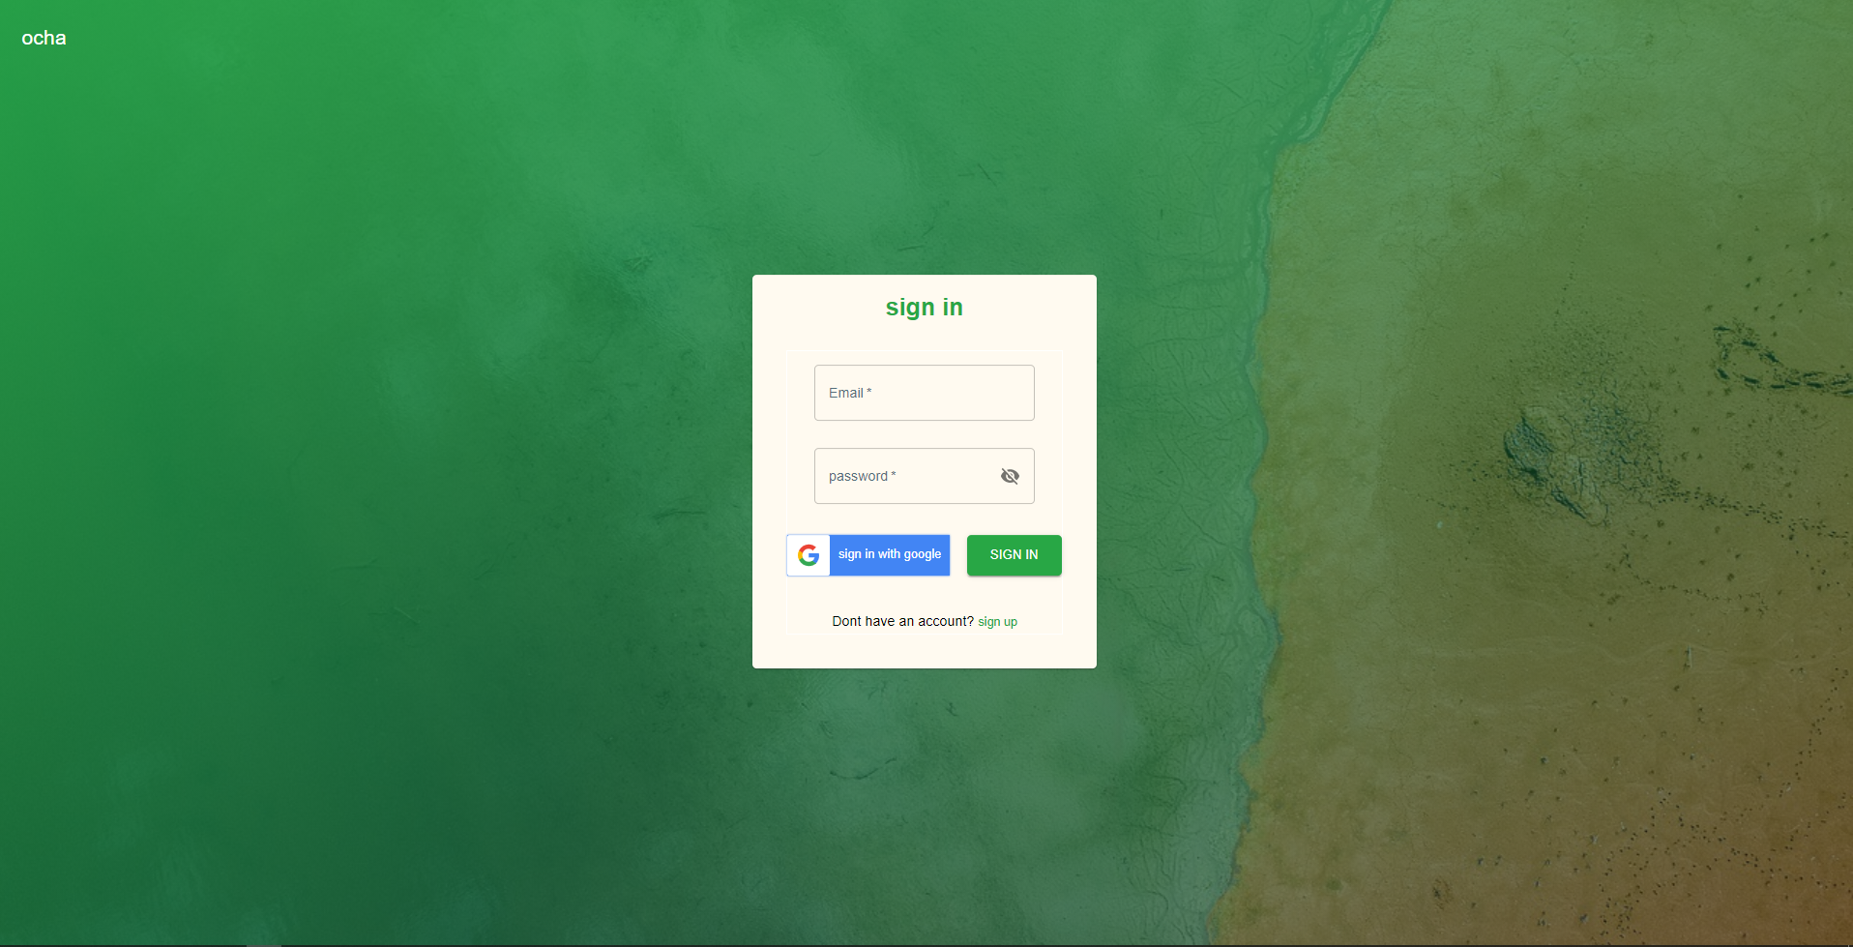
OCHA: snippet of the graphical interface of our e-waste management system that helps to improve and deliver a more effective waste disposal processes.
Features
Thanks
Problems
Implementation
Objectives
Methodologies

Slide 6
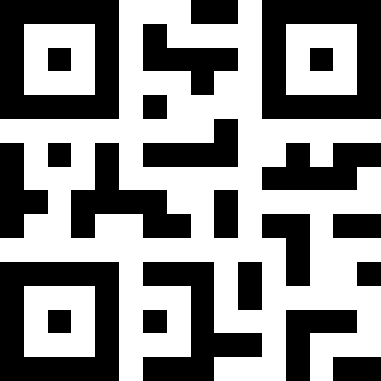





QR Code ID
Market Place
Modelling of waste bags with QR code to track bags identification.
Users can upload scrap items that are still considered valuable for sale to ensure reusability.
House-to-house collection
Online Payment
Thanks
Features
Problems
Waste pickup would be done from house to house as against at a particular collection point.
Users can pay for their waste bill online to increase administration efficiency
Methodologies
Objectives
Implementation
Different Disposable bags
Notification
Users get to use proper bags e.g. yellow, black, etc., for the different types of generated waste
Users get notified via mails and SMS for pick up date and time

Slide 7
THANK YOU
Problems
Features
Objectives
Thanks
Methodologies
Implementation

